Slide 1
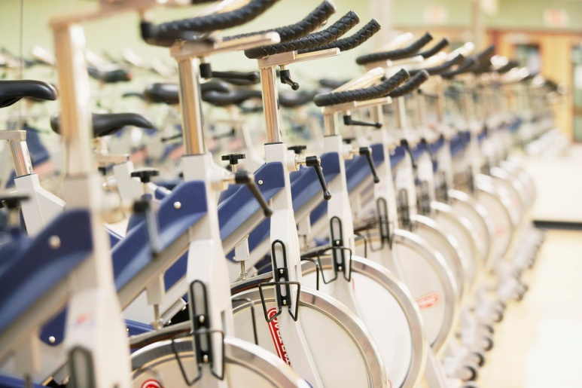
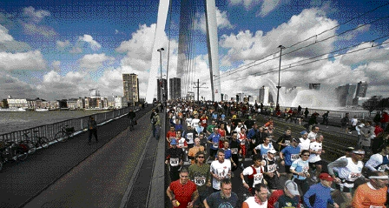
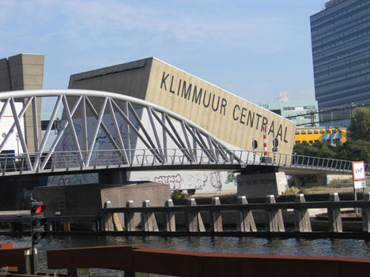
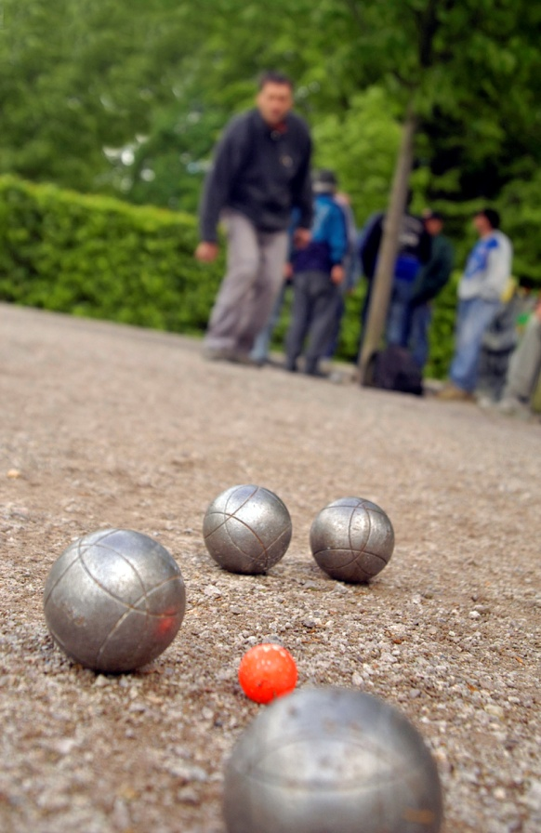
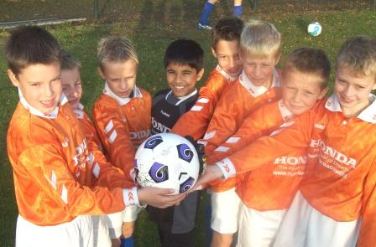
Challenges for sport facilities in the Netherlands
IDAN conference
Vejen, Denmark
26 May 2011
Remco Hoekman
Senior researcher
W.J.H. Mulier Institute
r.hoekman@mulierinstituut.nl

Slide 2
Content presentation
History of sport infrastructure
Sport participation, infrastructure and policy
Research outcomes
  Financial crisis
  Coalition agreements municipalities
  Accessibility of sport facilities
  Pricing of sport facilities
Challenges for sport infrastructure

Slide 3
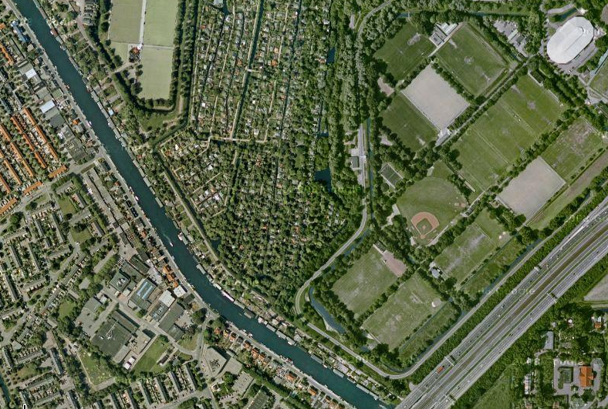
History of sport and urban planning
Start: democratization of sport
Sport facilities for lower class sports – hygiene and health
Sport facilities in periphery
Sport as an instrument to reach other goals

Slide 4

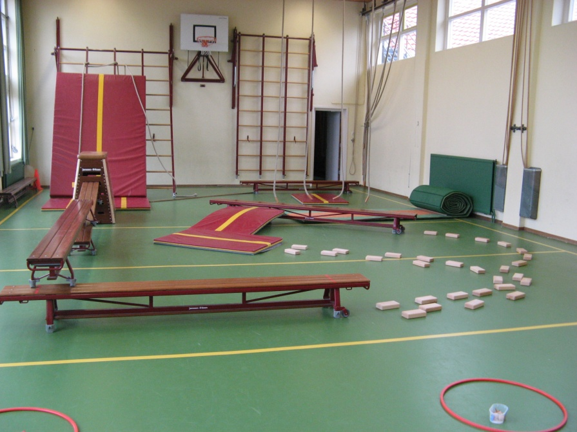


Ground pattern
Separation of sport and physical education
Functional separation – not sport inclusive
Ad hoc financing of sport facilities
Notes:
4

Slide 5
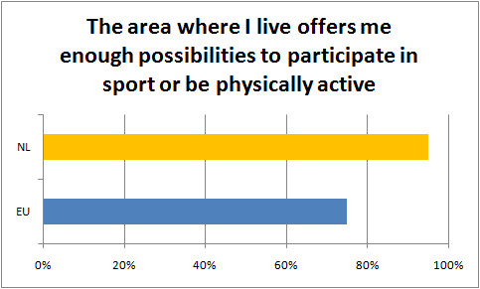
Current sports infrastructure
Highest score on satisfaction sport possibilities
(Eurobarometer 2009)

Slide 6
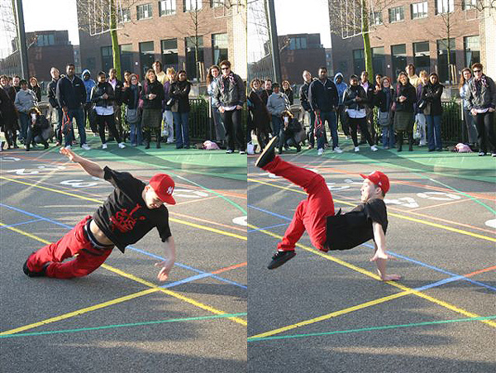
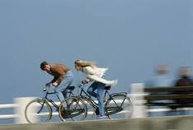
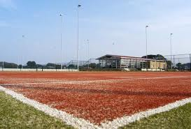
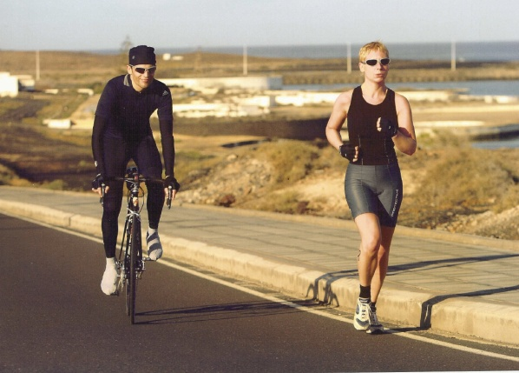
Sport en physical activity in the Netherlands
High sports participation (NL:64% - EU:46%)
Increase of unorganized and event sports (sports that are less related to municipal facilities)
High level of physical activity (NL:84% - EU:65%)
Notes:
6

Slide 7
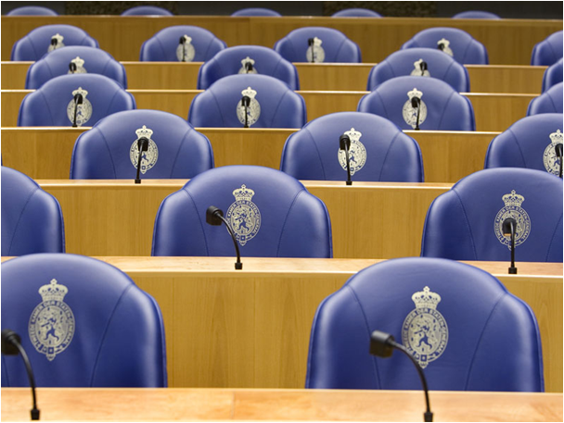
Sport in national coalition agreement
“Sport in all neighbourhoods is good for health as well as for safety.”
“The government will with the VNG [representing all municipalities] promote how sport and sport facilities can be an integral part of housing district plans in order to improve the livability”

Slide 8

National sport policy
Instrumental value of sport
  Medicine – social cohesion – livability
  marketing instrument – money generator
Olympic ambitions (Olympic Plan 2028)
  Sport on national urban planning agenda
  More and better facilities
  Increase sports participation and physical
  activity

Slide 9

Results:
Financial crisis and municipalities
28% cuts on sport (50% probably)
Less cuts on sport than other sectors
Strategy for cuts
  68% higher prices for facilities and less subsidies
  39% new management structures for facilities
  38% to stimulate market forces
Most cuts related to sport facilities

Slide 10
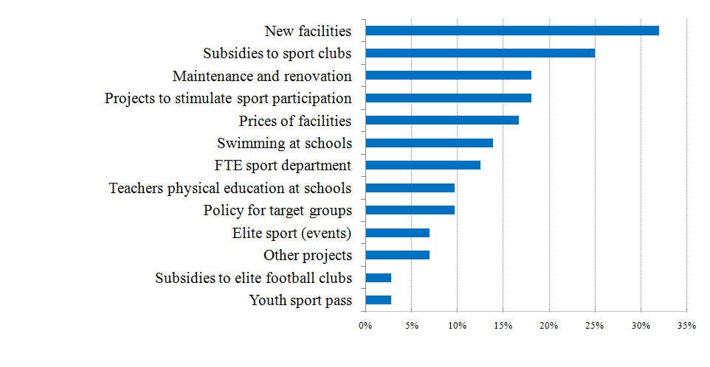
Cuts so far:

Slide 11
Results:
Financial crisis and municipalities
Additional cuts (expected)
  58% subsidies to sport clubs
  50% prices for facility use
  48% new facilities
  38% renovation current facilities
  35% sport for all projects
Less budget for sport (but ambitious)

Slide 12
Results:
Sport in coalition agreements
89% mentioned sport – 63% sport paragraph
Sport facilities most mentioned (77%)
  Multifunctional use/ higher occupation rate
  Privatise facilities as much as possible
  Reconsider historical price system of facilities
  Enlarge tasks for sport clubs (preparing fields)
  Shift to sport facilities and spaces for physical activity and recreation
  Better co-operation between (physical) education and sport

Slide 13

Results:
Sport in coalition agreements
Exploit instrumental value: linked with other sectors
Co-operation
  With sport clubs
  Sport and education
  Sport in the neighbourhood - nearby
  Public/private co-operation
Less budget for sport
  Better use of facilities
  Adjust subsidy and price system

Slide 14
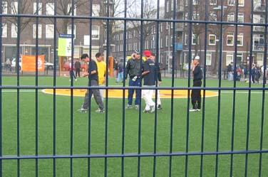
Facilitating sport
    What kind of facilities are needed?
      Development of facility use
    Where to place new facilities?
      Willingness to travel?
      Distance barrier for sport participation?
    How to fund and run facilities?
      Co-operation with private sector?
      Better occupation rates?
      Adjust price system?

Slide 15
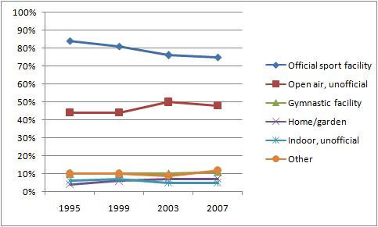
Development facility use
Facility use sport participants in cities 1995-2007
    Public road most used (29% of population)
Bron: SCP (AVO 1995-2007)

Slide 16
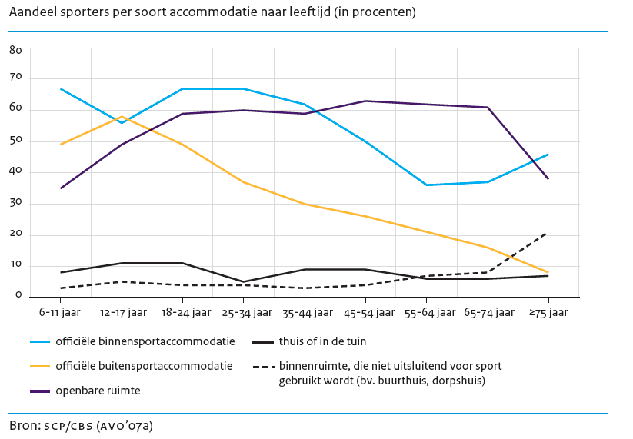
Facility use

Slide 17
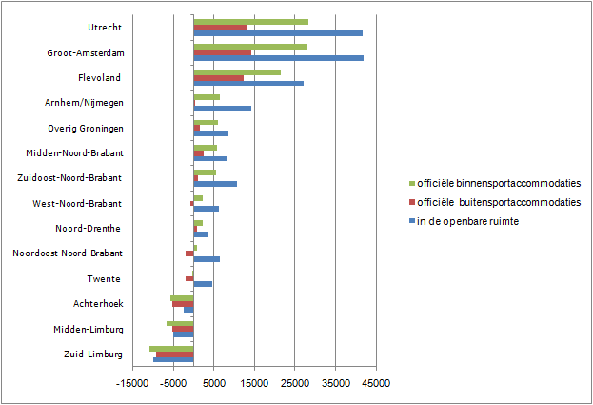
Difference in number of sport participants per facilitytype between 2007 and 2028
Source: SCP/CBS (AVO’07a), CBS Bevolkingsprognose (StatLine).
See Hoekman e.a. in Rapportage Sport 2010: Sport een leven lang

Slide 18
Theoretic model willingness to travel for sports

Slide 19
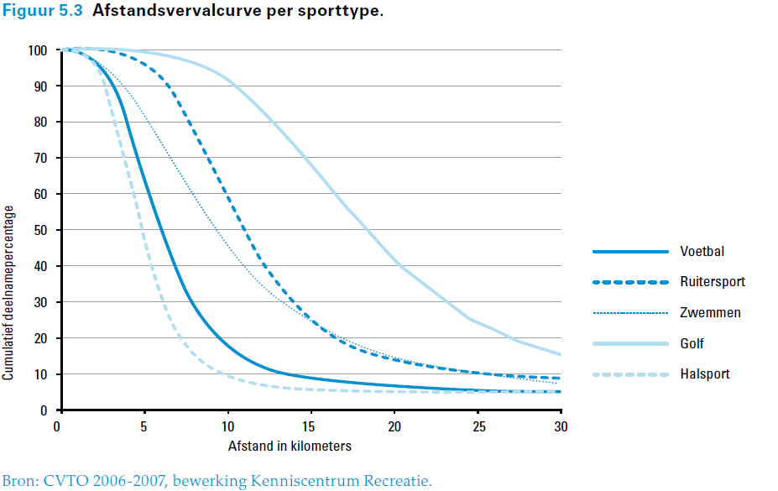
Bereidheid te reizen voor sport

Slide 20
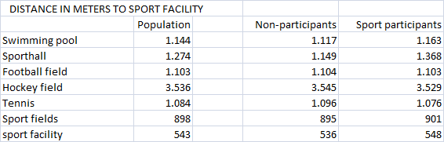
Distance to sport facilities sport participants and non-participants
    Population 13-75 year, large city in the Netherlands

Slide 21

Distance to facility as a barrier for sport participation?
    Percentage of non-participants

Slide 22
Conclusion accessibility:
High satisfaction sport possibilities (95%)!
Distance to sport facility marginal barrier
  More likely to be a barrier for immigrants
  Willingness to travel
Choice for sport facility not only based on distance
Possibility to cluster facilities
Incorporate sport with broader needs for physical activity friendly environments
Bring sport closer to less motivated target groups

Slide 23
Pricing and maintenance of facilities
Case study of 4 cities
What is the relation between policy and subsidy?
Number of facilities (per inhabitant)
Cost coverage percentage of facilities
Focus on subsidies for sport clubs
Historical based social pricing – with a lot of exceptions
Prices are a given – no policy instrument!
Ad-hoc financing (problem with decrease of inhabitants)

Slide 24

Occupation rate indoor facilities
100 % =14 rented hours a day, 7 days a week, 40 weeks a year
Indoor facilities on average occupied 7 hours a day
TABLE: OCCUPATION RATE (%)

Slide 25
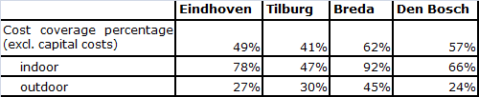
Sport facilities cost money
Municipalities pay half of the costs of sport facilities (on average up to 30 euro per inhabitant)
Indoor higher percentage of the true costs
Differences partly based on management and maintenance

Slide 26

Indoor sports participants treated unfair
Volleyball player pays 5 times as much as football or field hockey player!
Is that policy or just a coincidence?

Slide 27
Conclusion price system:
No policy behind price differences
Possibilities to rethink pricing system
How to better run sport facilities?
  Need to increase occupation rate indoor
  Higher prices for outdoor facilities
Outsource maintenance

Slide 28
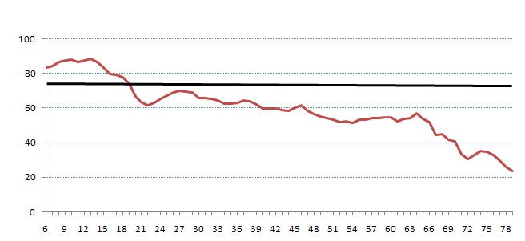
Better use
Target groups
  Company sports
  Not only youth – increasing attention for elderly

Slide 29
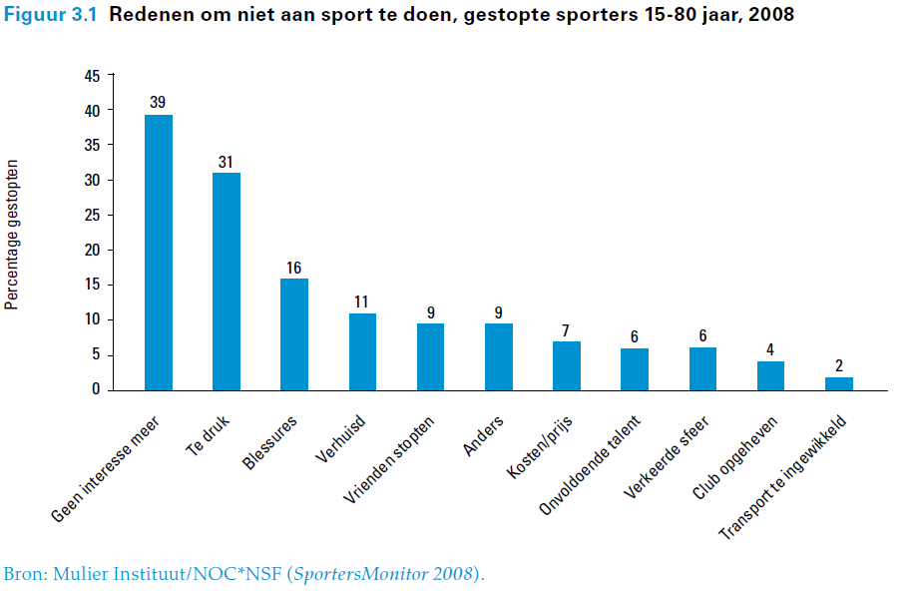
Higher prices?
Kesenne (2011) – Price no factor, time constraint is

Slide 30
To summarize: challenges for the future
Need for more facilities (in the city) – no money
  Increase opportunities in public space
  Clustering of facilities (close to schools)
  Public-private partnerships
Increase revenue of sport facilities
  Focus on new target groups
  Co-operate with education, culture and welfare
  Increase prices for outdoor sports (visualize investment to the public) and lower cost (outsourcing)

Slide 31
Let policy guide you
What are the policy objectives?
How do sport facilities support to policy objectives?
Can the ‘market’ contribute to the objectives?
Can you co-operate with other sectors and use their activities to reach your goals (green spaces – physical education)?
With ‘awareness’ towards effective interventions/facilities!

Slide 32
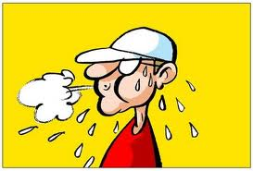
Questions?
Remco Hoekman (W.J.H. Mulier Institute) – r.hoekman@mulierinstituut.nl

